Slide 1
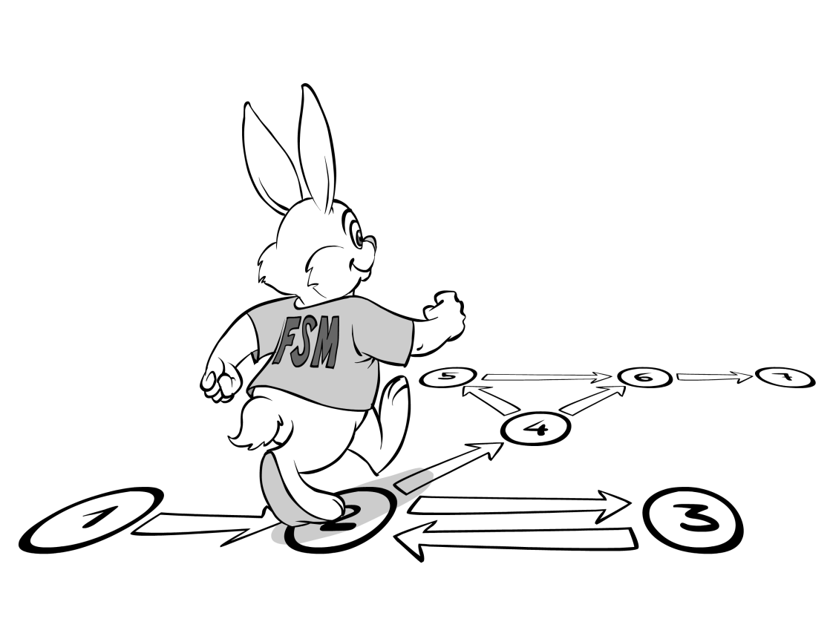
Finite State Machine
(Automaton)
2nd Semester 2017-2018
Dr. Abdulhussein M. Abdullah
Lec #3

Slide 2
Given a language, how to define DFA?
Creative process requiring you to:
Imagine yourself in the place of the machine, reading symbols of the input, and trying to determine if it should be accepted.
Remember at any point you have only seen a part of the input, and you don’t know when it ends.
Find finite amount of info, based on which string accepted/rejected
From step (iii), determine number of states and then transitions.

Slide 3
Example: Diagram of DFA L = {a^{2n + 1} | n >= 0}
Answer:
L = {a, aaa, aaaaa, ...}

Slide 4
JFLAP Step-By-Step
aaa

Slide 5
JFLAP Step-By-Step
aaa

Slide 6
JFLAP Step-By-Step
aaa

Slide 7
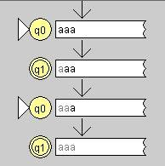
JFLAP Step-By-Step
aaa

Slide 8
Example: L(M) = {w in {a,b}* | w contains even no. of a's}

Slide 9
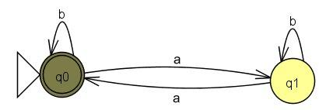
JFLAP Step-By-Step
aa

Slide 10
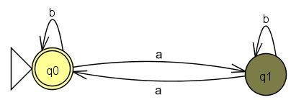
JFLAP Step-By-Step
aa

Slide 11
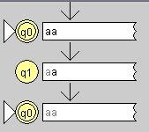
JFLAP Step-By-Step
aa

Slide 12
JFLAP Step-By-Step
ab

Slide 13
JFLAP Step-By-Step
ab

Slide 14
JFLAP Step-By-Step
ab

Slide 15
Regular Languages
Definition: A Language is regular iff there is a DFA that accepts it.
Examples:
φ
{ε}
Σ*
{w in {0,1}* | second symbol of w is a 1} Exercise
{w in {0,1}* | second last symbol of w is a 1} Exercise
{w in {0,1}* | w contains 010 as a substring} - (importance?)

